Slide 1
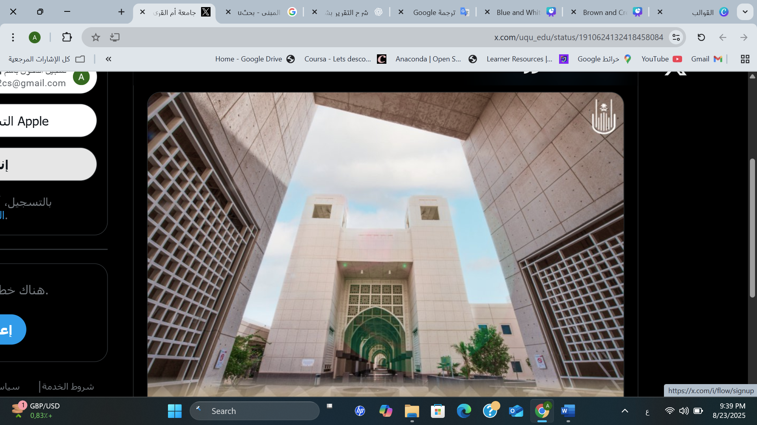
CO-OP Report
PRESENTATION
Presented By: Amjad Alamri
2025-1447

Slide 2

INTRODUCTION

Slide 3
MAIN POINTS
ABOUT THE TRAINING FACILITY
TRAINING PLAN & TASKS ASSIGNED DURING THE TRAINING PERIOD.
ACHIEVEMENTS AND RESULTS ACHIEVED
GAINED SKILLS AND PRACTICAL EXPERIENCE
CONCLUSION

Slide 4
ABOUT THE TRAINING FACILITY
About UQU-Deanship of Information Technology and E-Learning
The Deanship is responsible for advancing UQU’s digital transformation agenda in alignment with Saudi Vision 2030. It plays a central role in integrating technology into teaching, learning, and administrative processes across campuses via modern infrastructure, efficient systems, and secure networks.
Vision
To provide smart, comprehensive, interactive, and integrated electronic services that are in line with international specifications and standards.
Mission
To be one of the top three Saudi universities that provide optimum services in the field of information technology with superior quality, comprehensively and safely.

Slide 5
TRAINING PLAN & TASKS ASSIGNED dURING THE TRAINING PERIOD.
During my training period, I completed approximately 720 hours, spanning over four months, with a focus on key AI concepts. Each module was structured into a theoretical and a practical part. The training plan was structured into modules, each targeting a specific area. The plan concluded with a project. This final stage brought together all the concepts and skills gained during the program.

Slide 6
TRAINING PLAN & TASKS ASSIGNED DURING THE TRAINING PERIOD.
Read the first chapter of Sebastian Raschka's book
Watch demos of the OpenAI API and ChatGPT
Implement a simple Attention model and explain the difference between the Decoder and the Encoder. Use GitHub to test actual code.
Analyze the difference between: Pretraining vs. Instruction Tuning
Download an open model and test it.
Use the OpenAI API to create a simple application and test content recall in two languages.
Compare zero-shot vs. few-shot vs. chain-of-thought prompting.
Generate and analyze multiple outputs and modify commands based on the outputs.
Compile and test 10 commands for different tasks (course description, objectives, presentation, question, etc.)
Apply Bloom’s taxonomy to analyze vocabulary sequences.
Analyze unsuccessful outputs and document the resulting commands.
Set up a project using Flask.
Adjust temperature, length, and models used.
Use python-pptx to export courses.
Develop an actual course using all the acquired skills.

Slide 7
ACHIEVEMENTS AND RESULTS ACHIEVED

Slide 8
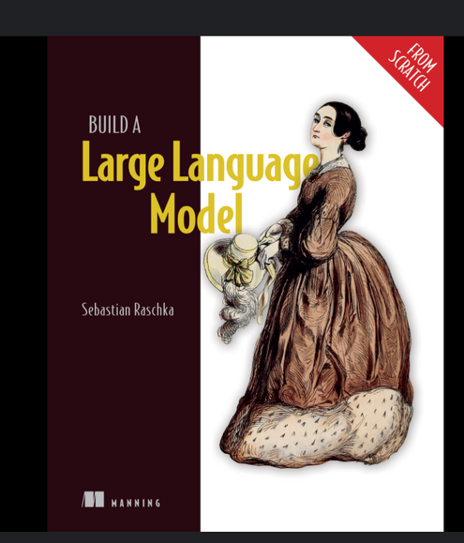
GENERATIVE AI AND LARGE LANGUAGE MODELS (LLMS)
Introduction to LLMs and GPT: Reading and understanding the first chapter of the book Sebastian Raschka “Building a large language model”
What is a large language model (LLM)?
LLMs applications
Stages of Building the LLMs
introduction to transformers & what is GPT?
Why we build a model from scratch ?

Slide 9
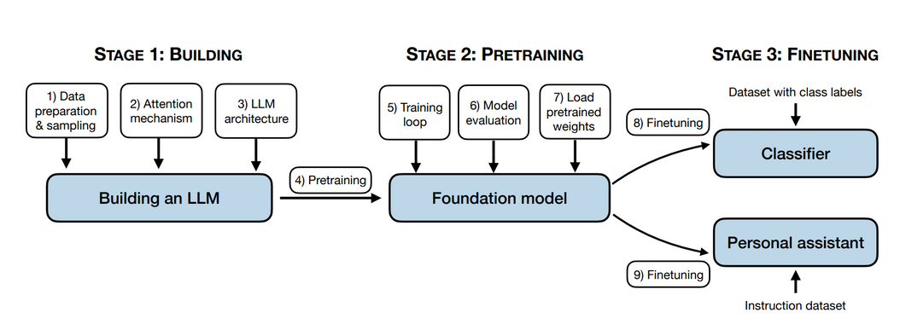
GENERATIVE AI AND LARGE LANGUAGE MODELS (LLMS)
Introduction to LLMs and GPT: Reading and understanding the first chapter of the book Sebastian Raschka “Building a large language model”
Stages of Building the LLMs:

Slide 10

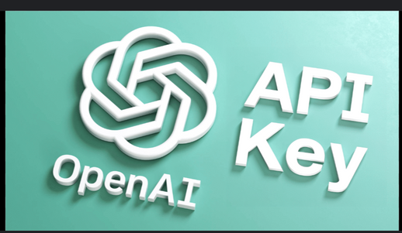
GENERATIVE AI AND LARGE LANGUAGE MODELS (LLMS)
Watching Demos about ChatGPT and the OpenAI API
What is the ChatGPT & versions
What is the OpenAI API ?

Slide 11
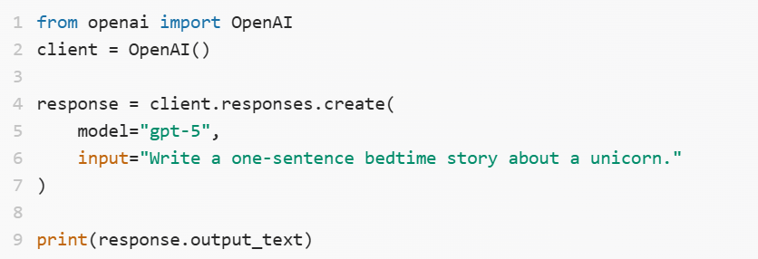
GENERATIVE AI AND LARGE LANGUAGE MODELS (LLMS)
API request Example:

Slide 12
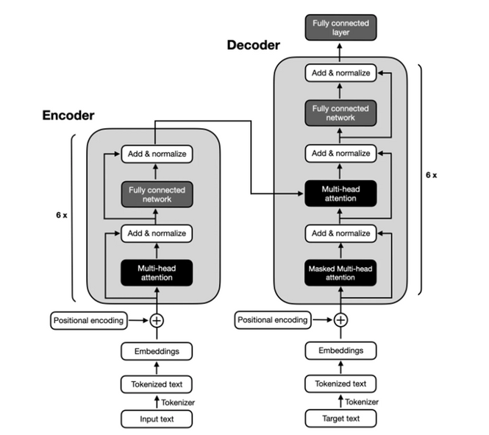
TRANSFORMER ARCHITECTURE UNDERSTANDING:
explain the difference between the LLM transformer encoder VS decoder using GitHub to test an actual code

Slide 13
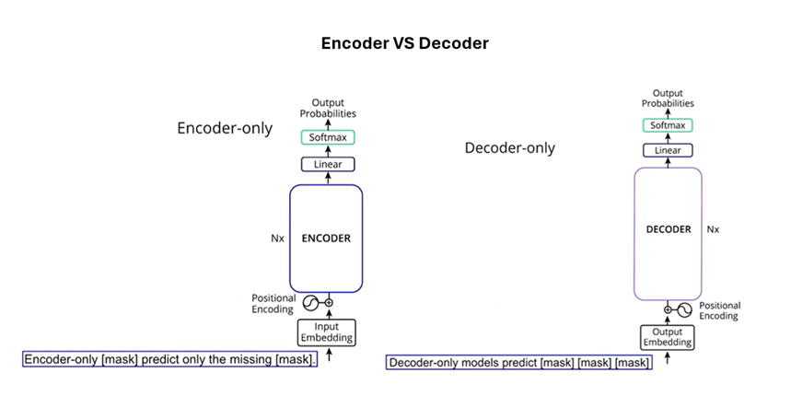
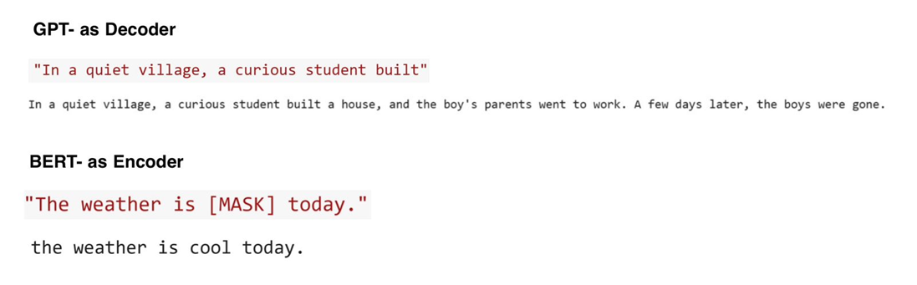
TRANSFORMER ARCHITECTURE UNDERSTANDING:
explain the difference between the LLM transformer encoder VS decoder using GitHub to test an actual code

Slide 14
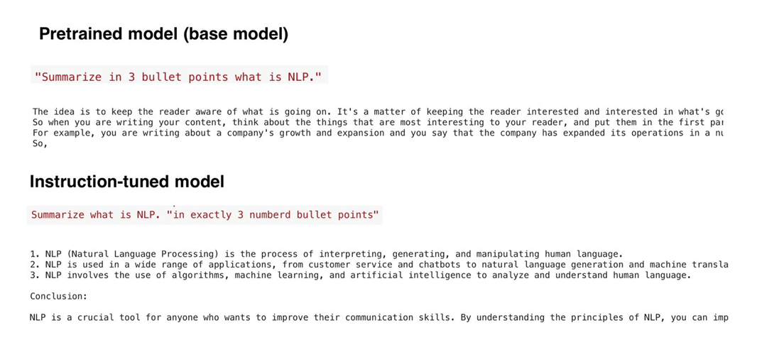
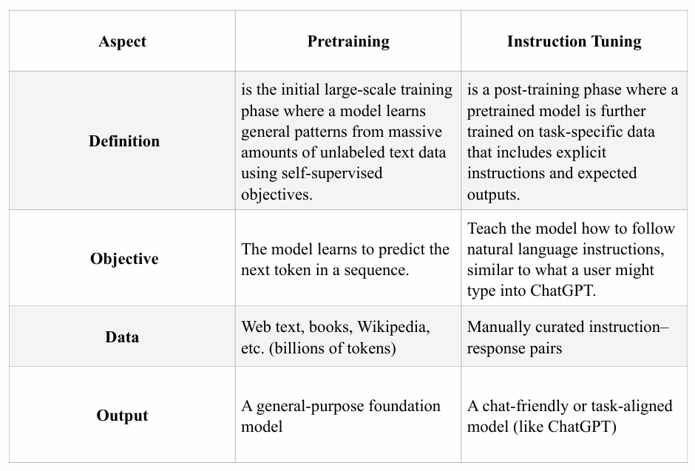
GENERATIVE AI AND LARGE LANGUAGE MODELS (LLMS)
Pre-training VS fine-tuning

Slide 15
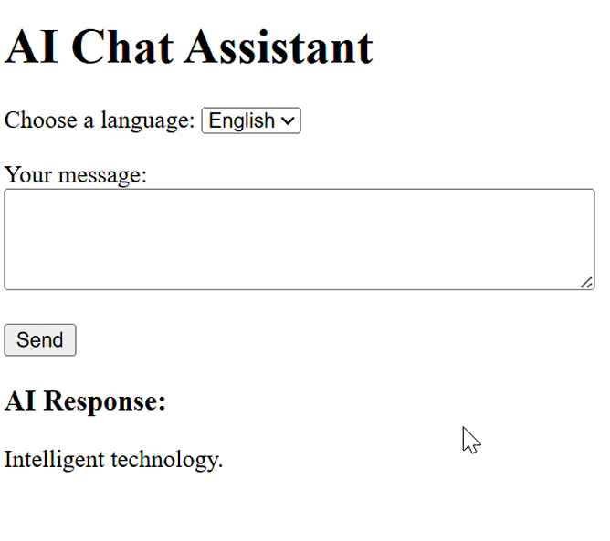
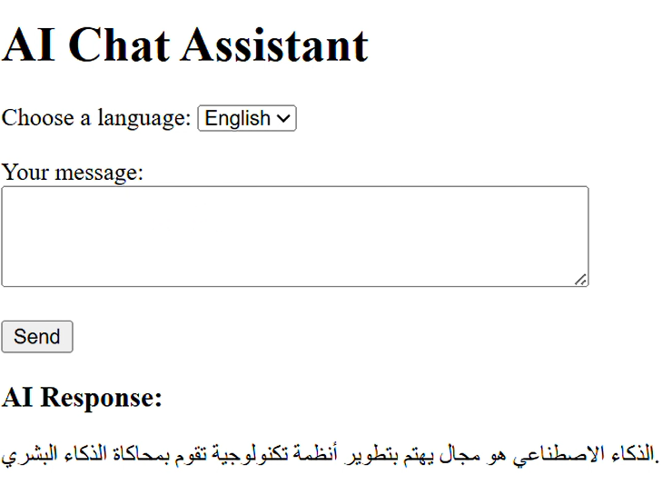
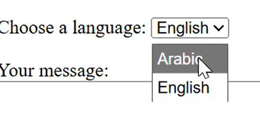
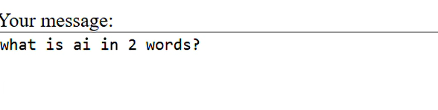
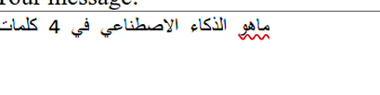
GENERATIVE AI AND LARGE LANGUAGE MODELS (LLMS)
Use the OpenAl API to create a simple application & Try invoking content in two languages

Slide 16
PROMPT ENGINEERING AND OUTPUT QUALITY IMPROVEMENT
Overview & Prompt Engineering techniques
What do we mean by prompt and Prompt engineering?
Prompt Engineering techniques

Slide 17
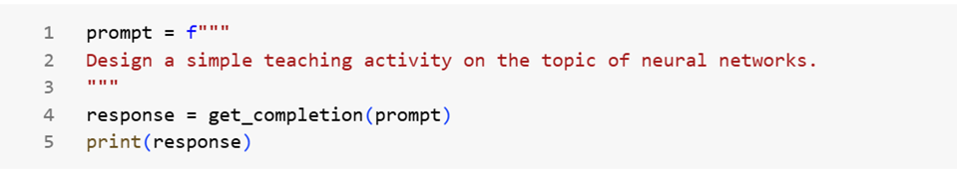
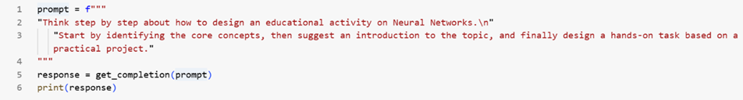
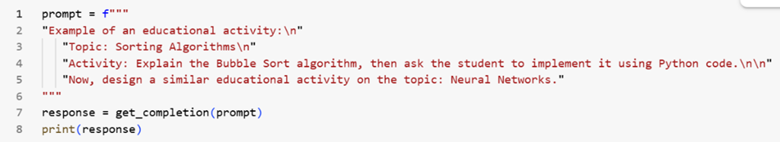
PROMPT ENGINEERING AND OUTPUT QUALITY IMPROVEMENT
Prompt Engineering techniques
1- Zero-shot prompting
1- Chain-of-thought prompting
1- Few-shot prompting

Slide 18
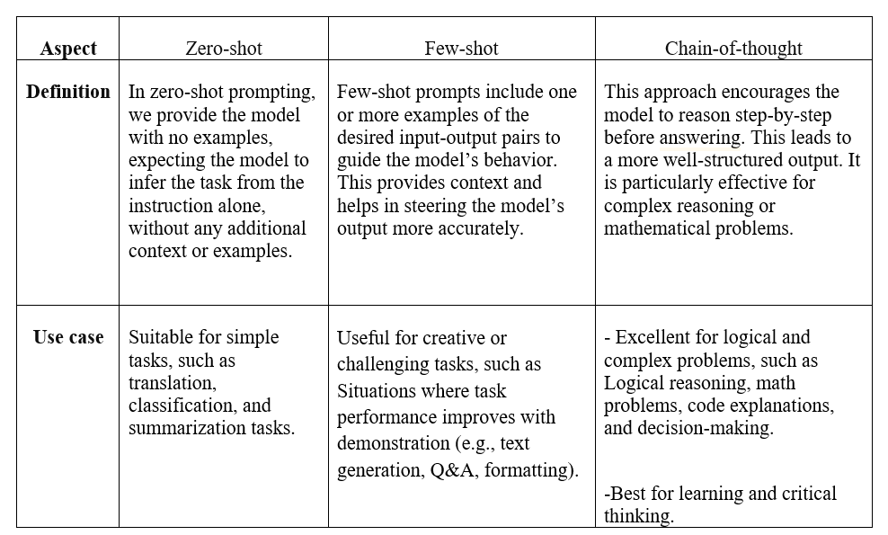
PROMPT ENGINEERING AND OUTPUT QUALITY IMPROVEMENT
Prompt Engineering techniques

Slide 19
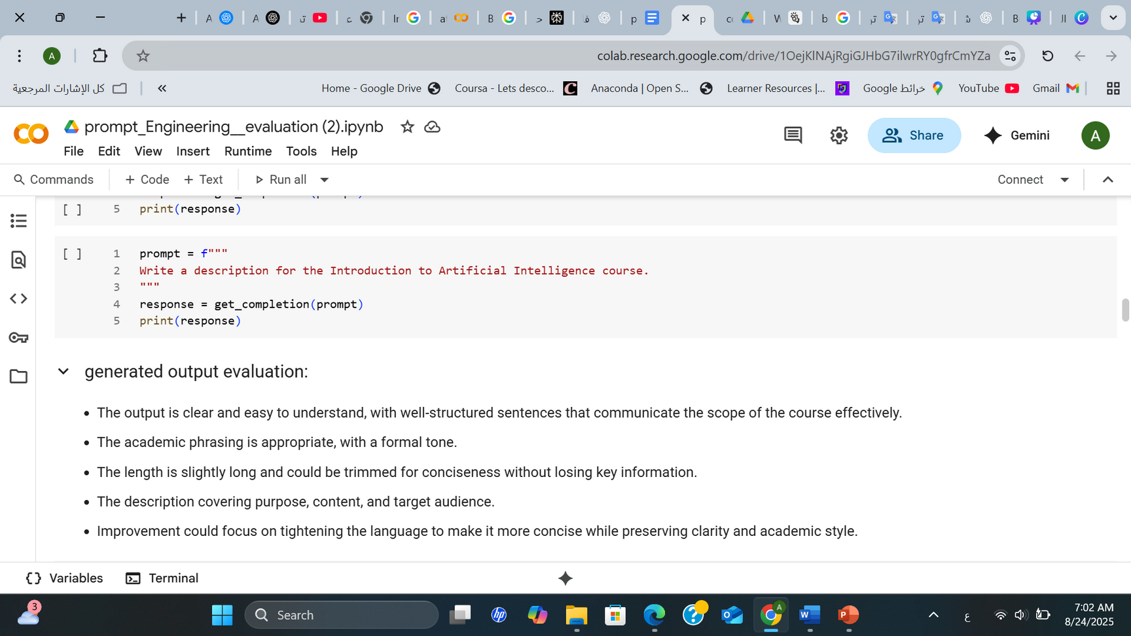
PROMPT ENGINEERING AND OUTPUT QUALITY IMPROVEMENT
Evaluate prompts effectiveness
Output:
1. Understand the fundamental concepts and techniques of machine learning, including supervised and unsupervised learning, regression, classification, clustering, and dimensionality reduction.
2. Develop the ability to apply machine learning algorithms to real-world datasets, including data preprocessing, model selection, evaluation, and interpretation of results.
3. Gain practical experience in implementing machine learning algorithms using popular programming languages and libraries such as Python and scikit-learn, and be able to effectively communicate and present findings to stakeholders.

Slide 20
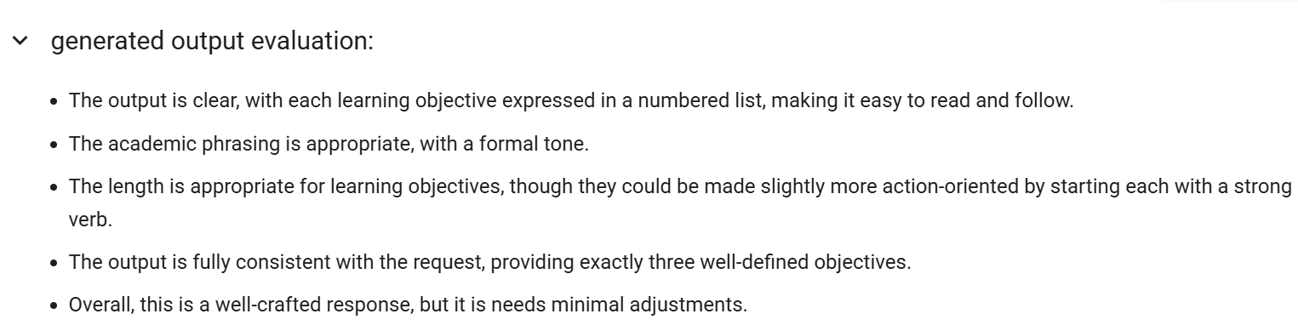
PROMPT ENGINEERING AND OUTPUT QUALITY IMPROVEMENT
Evaluate prompts effectiveness

Slide 21
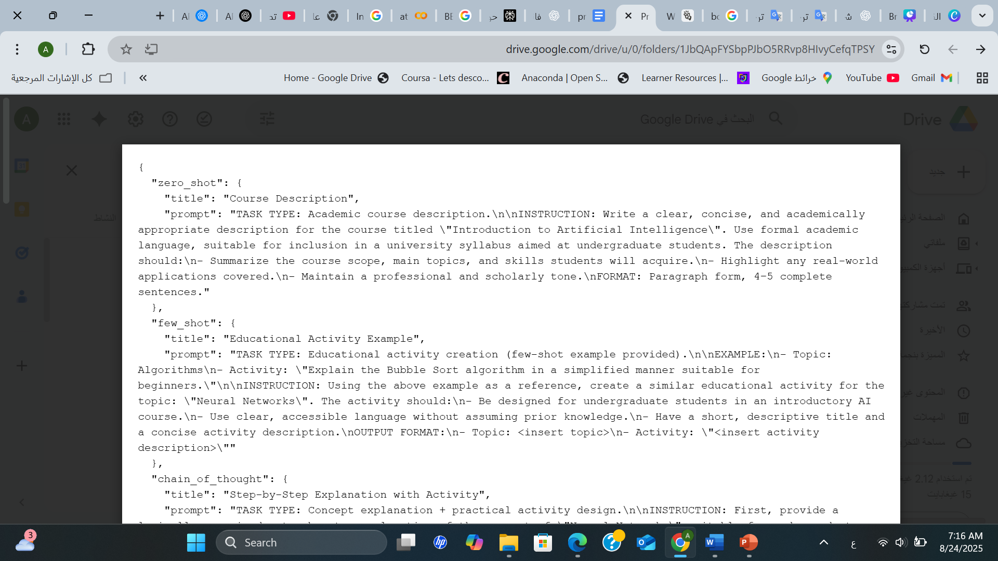
PROMPT ENGINEERING AND OUTPUT QUALITY IMPROVEMENT
Developing prompts library

Slide 22
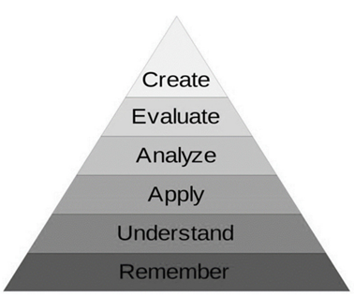
EVALUATING GENERATIVE CONTENT LINGUISTICALLY
AND PEDAGOGICALLY
What does Bloom's taxonomy mean?
a framework for classifying the levels of thinking and knowledge that the learner must achieve during the educational process. Bloom's Taxonomy contains six main levels, each representing a different type of cognitive skill: remember, understand, apply, analyze, evaluate, create/synthesize; it helps in writing measurable objectives, such as: The student must be able to recall key terms in each topic, and the student must explain a specific concept with a clear understanding. In addition, it helps in designing activities and gradual assessment. In the context of analyzing the generated outputs, it will be used to classify each learning objective resulting from the AI mode.

Slide 23
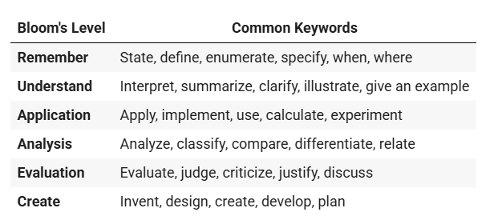
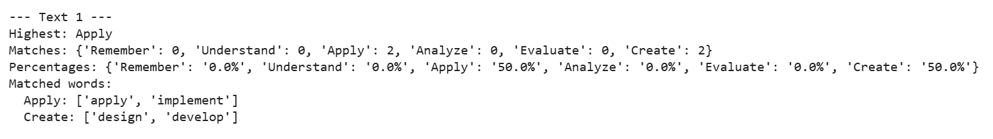
EVALUATING GENERATIVE CONTENT LINGUISTICALLY
AND PEDAGOGICALLY

Slide 24
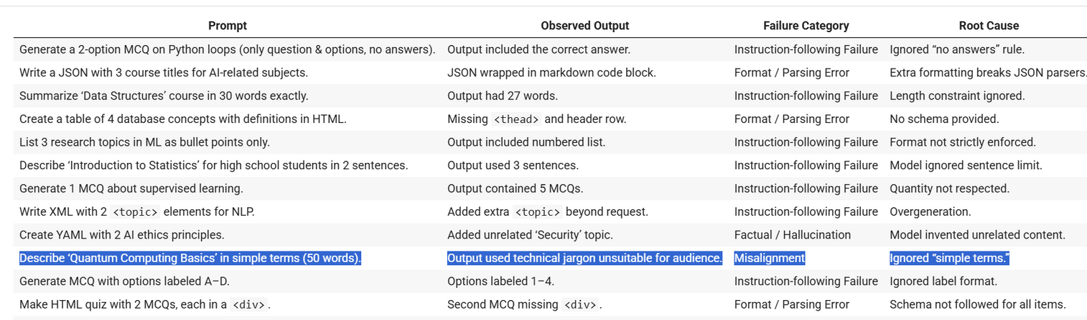
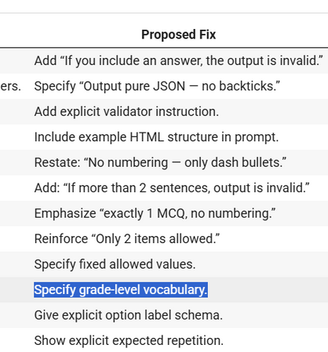
EVALUATING GENERATIVE CONTENT LINGUISTICALLY
AND PEDAGOGICALLY
Review of failure cases: Analyze unsuccessful outputs and document the resulting commands.

Slide 25
BUILDING INTERACTIVE INTERFACES TO USE ARTIFICIAL INTELLIGENCE IN COURSES DEVELOPMENT
Creating a simple tool to generate vocabulary
Practical implementation:
This application is a lightweight web service based on Flask for vocabulary generation. It integrates corpus-derived frequency estimates (expressed on the human-interpretable Zipf scale) with lexical-semantic information from WordNet to return words filtered by frequency “level” and part of speech, together with definitions, synonyms, and example sentences. The system exposes both a browser interface and a JSON API for programmatic access.
Purpose:
Pedagogical vocabulary selection often requires balancing (common words learners will encounter) with challenge (less frequent, academically useful terms).

Slide 26
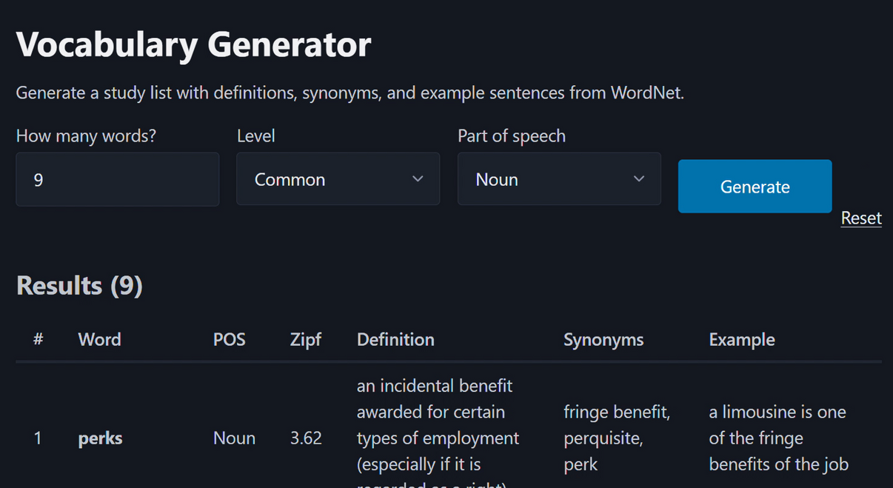
BUILDING INTERACTIVE INTERFACES TO USE ARTIFICIAL INTELLIGENCE IN COURSES DEVELOPMENT
Creating a simple tool to generate vocabulary

Slide 27
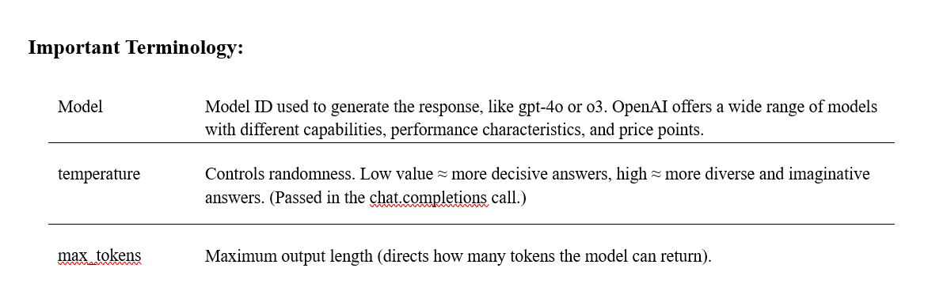
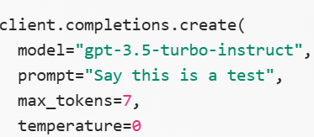
ADVANCED SETTINGS FOR THE MODEL & FORMATTING AND EXPORTING OUTPUTS:
Adjusting temperature, length, and models

Slide 28
ADVANCED SETTINGS FOR THE MODEL & FORMATTING AND EXPORTING OUTPUTS:
Use python-pptx and python-docx in generated content, create a presentation, or an automated tutorial.
PPTX and DOCX files are based on Open XML and can be generated programmatically without installing Microsoft Office, using the following Python libraries:
• python-pptx: For creating dynamic PowerPoint presentations (titles, bullet points, lesson slides, etc.).
• python-docx: For generating structured Word documents (titles, tables, paragraphs, etc.).

Slide 29
FINAL PROJECT - AI-POWERED EDUCATIONAL COURSE GENERATOR
Overview - Project idea
A web application with a professional and user-friendly interface transforms a brief request into a comprehensive educational course. The system receives user requests: subject, academic level, language (Arabic or English), duration in minutes, and number of chapters. It then generates a plan of chapters and lessons, with clear content and learning objectives, generates multiple-choice questions, saves the course in a database, and finally, exports a PowerPoint (PPTX) presentation ready for download.
Purpose
Create an app that can automatically generate complete educational courses based on user input in just a few minutes.

Slide 30
FINAL PROJECT - AI-POWERED EDUCATIONAL COURSE GENERATOR
Key features
Flexible Input Form
Comprehensive AI Content Generation
Structured Data Storage
User-Friendly interface & support bilingual
Export generated content to PowerPoint
Pedagogical Alignment

Slide 31

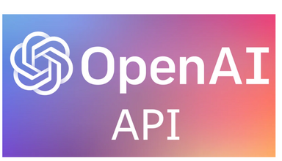

FINAL PROJECT - AI-POWERED EDUCATIONAL COURSE GENERATOR
Implementation & Tools
Bootstrapped the application
Validation & generation via OpenAI
Structured outputs and two-phase generation:
Quiz rules (pre-defined before generation)
Data storage
Display & user interaction
Export

Slide 32
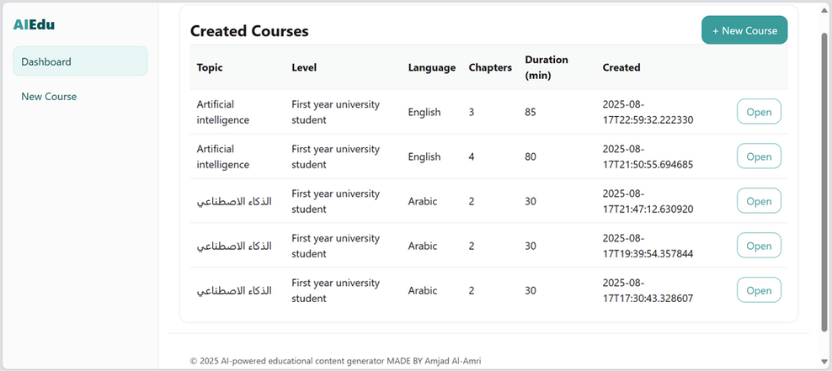
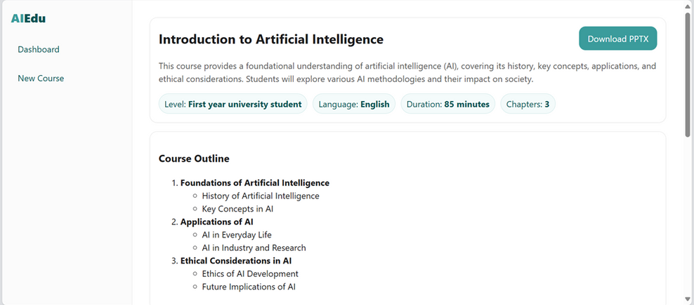
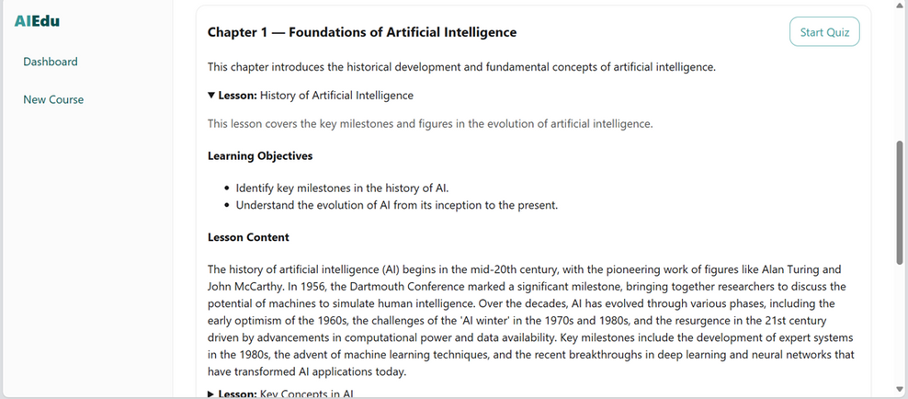
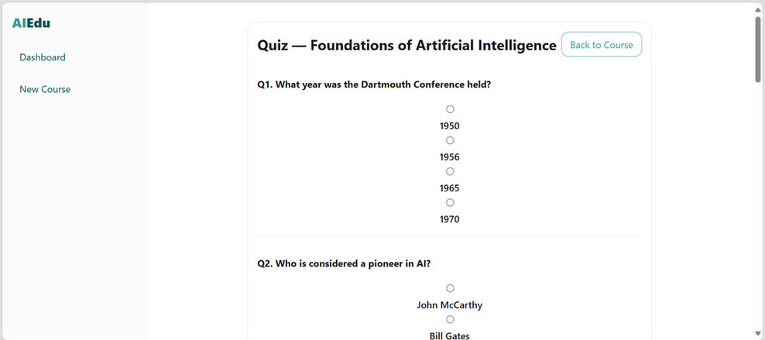
FINAL PROJECT - AI-POWERED EDUCATIONAL COURSE GENERATOR
user interface

Slide 33
COURSES ATTENDED DURING THE TRAINING
Microsoft AI & ML Engineering Professional Certificate
Introduction
In this part, I will summarize my learning journey while completing the Microsoft AI & ML Engineering Professional Certificate, a comprehensive 178-hour program offered through Microsoft and Coursera. The program included five structured courses covering the foundations of AI/ML, algorithms, troubleshooting agents, cloud-based AI/ML engineering, and advanced techniques. Each course provided me with theoretical knowledge, practical applications, and reflective experiences that significantly strengthened my expertise in artificial intelligence and machine learning.

Slide 34
COURSES ATTENDED DURING THE TRAINING
Microsoft AI & ML Engineering Professional Certificate
1. Foundations of AI and Machine Learning
The first course introduced me to the AI/ML environment, focusing on the lifecycle of data-driven solutions. I learned about data management strategies, preprocessing methods, and the significance of high-quality datasets. I also studied major model frameworks such as TensorFlow, PyTorch, and Scikit-learn, reflecting on their use cases in research and enterprise settings.

Slide 35
COURSES ATTENDED DURING THE TRAINING
Microsoft AI & ML Engineering Professional Certificate
2. AI and Machine Learning Algorithms and Techniques
In this course deepened my understanding of machine learning paradigms. I studied supervised learning techniques such as regression and classification, and unsupervised learning techniques such as clustering and dimensionality reduction. Reinforcement learning introduced me to the agent-environment interaction model, while deep learning covered neural network architectures.

Slide 36
COURSES ATTENDED DURING THE TRAINING
Microsoft AI & ML Engineering Professional Certificate
3. Building Intelligent Troubleshooting Agents
In this course, I moved from algorithms to applied AI. I studied fine-tuning large language models (LLMs) for domain-specific tasks, and the fundamentals of AI agents. I explored natural language processing techniques such as intent recognition, named entity recognition, and sentiment analysis for troubleshooting contexts.

Slide 37
COURSES ATTENDED DURING THE TRAINING
Microsoft AI & ML Engineering Professional Certificate
4. Microsoft Azure for AI and Machine Learning
I began by setting up the Azure AI/ML environment, where I realized how integrated services streamline the workflow. I then managed data preparation and training pipelines using Azure Data Factory. I learned the basic steps for setting up an effective Azure environment for AI and machine learning projects. I understood how to create and configure Azure machine learning workspaces. I discussed the importance of choosing the right Azure subscriptions and resources to ensure optimal performance. I realized that properly setting up an environment is the first step toward building scalable and reliable AI and machine learning solutions.

Slide 38
COURSES ATTENDED DURING THE TRAINING
Microsoft AI & ML Engineering Professional Certificate
5. Advanced AI and Machine Learning Techniques
I studied advanced ML techniques such as ensemble learning, boosting, and hyperparameter tuning. I reflected on trade-offs between model accuracy, interpretability, and efficiency. I also deeply explored ethical considerations, such as fairness, bias mitigation, and accountability. I understood that AI/ML systems can unintentionally discriminate, and engineers must design with transparency in mind

Slide 39
GAINED SKILLS AND PRACTICAL EXPERIENCE
Understand the basic concepts of generative AI
Be able to interpret the Transforme architecture
Understand the (LLM) model lifecycle
Run a ready-made model via API
Design commands appropriate for the educational content
Critical thinking in evaluating output
Design reusable tools
Analysis of the alignment of outputs with educational objectives
Create a common errors guide and identify model limitations
Build a simple application for generating content
Precisely control model behavior
Organize presentations and textual output
Combine theoretical and practical knowledge

Slide 40
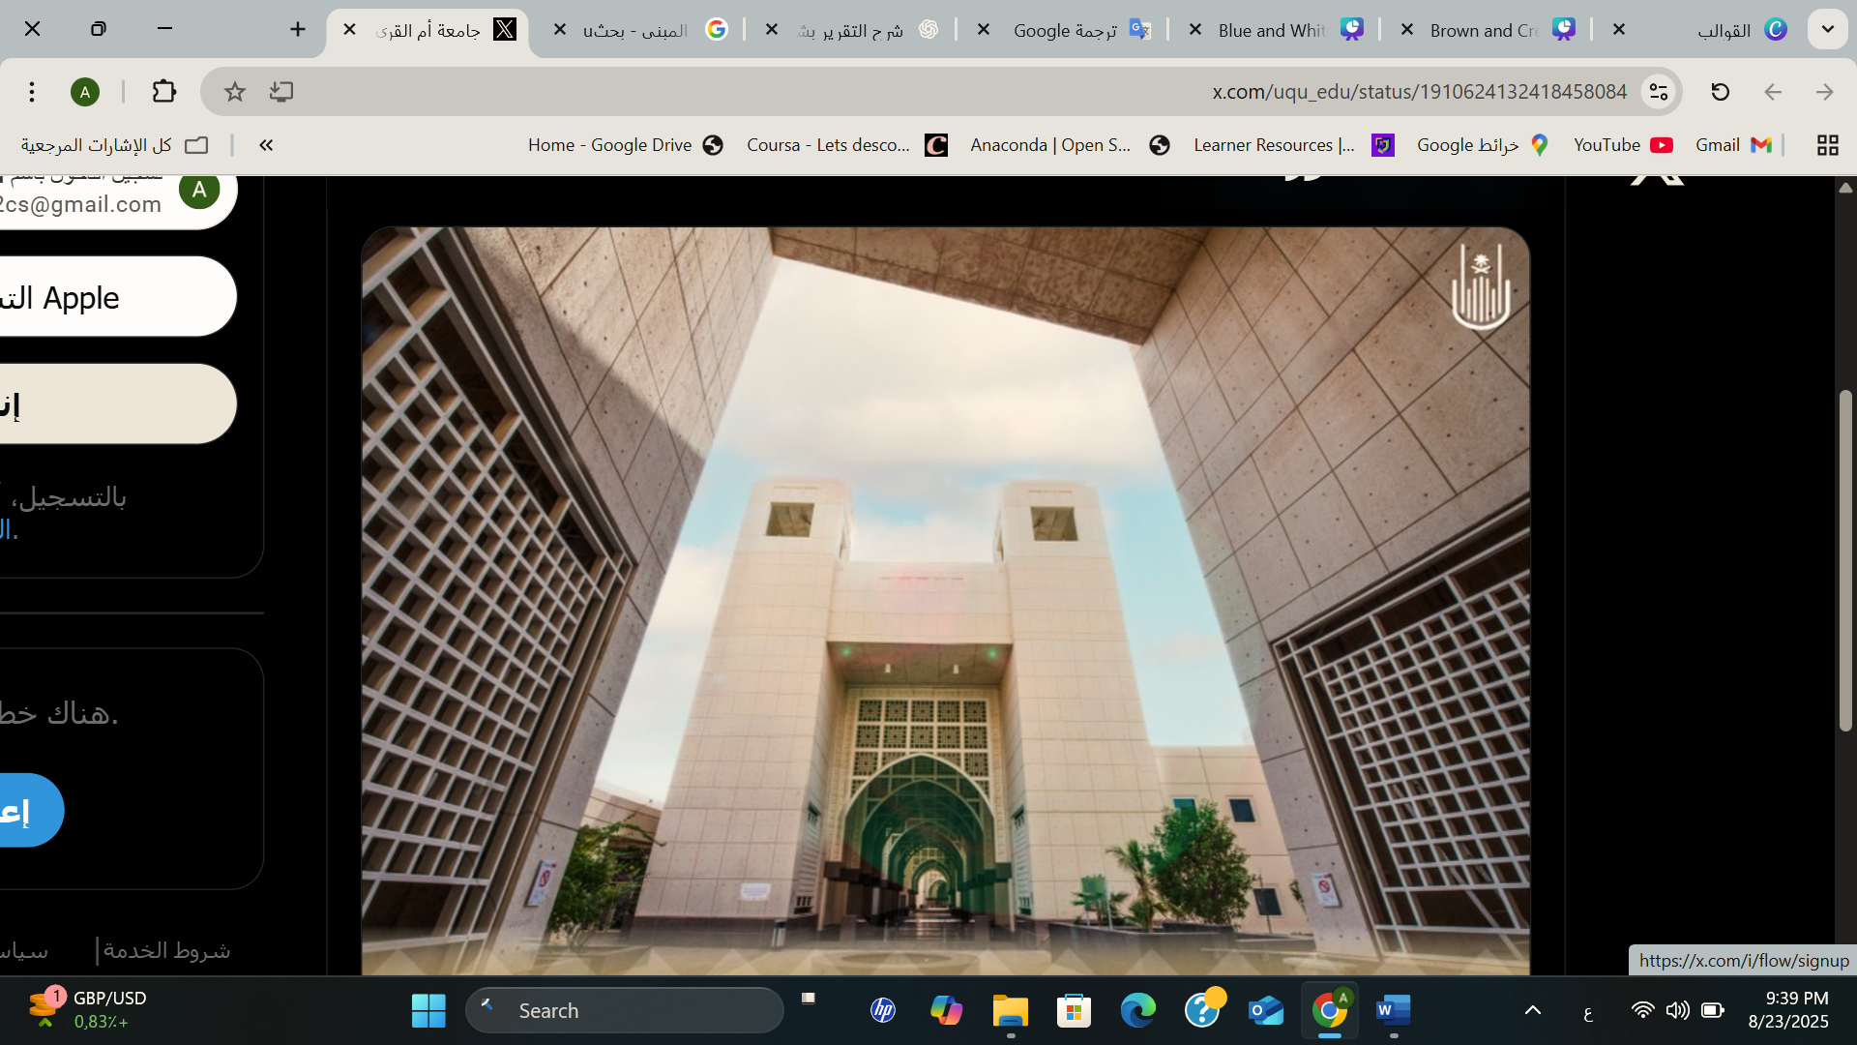
CONCLUSION

Slide 41
THANK YOU
Presented By: Amjad Alamri
2025-1447

